Slide 1
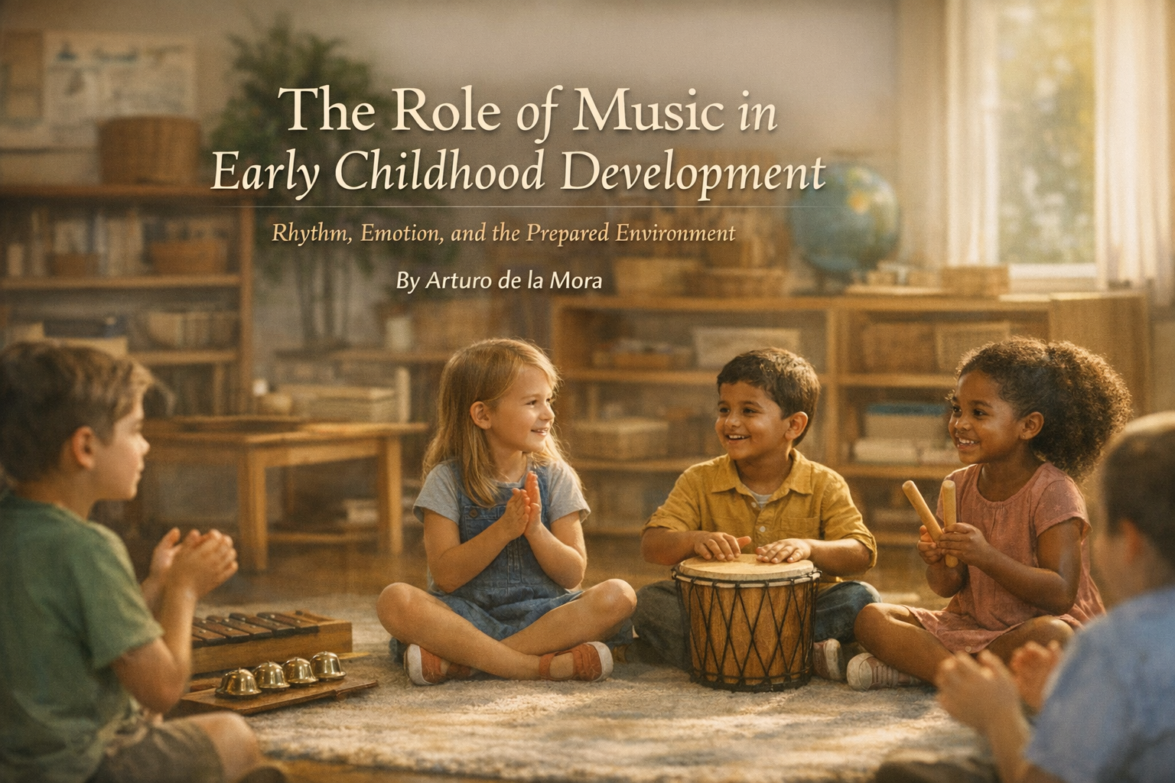
Notes:
1 - Ohhh… I’m sorry… is this an English-speaking conference? My apologies.
As you may have already noticed, English is not my first language. But here I am, and I’ll do my very best to present today using my finest Shakespearean English.
After such a pompous introduction… My name is Arturo. I’m a human bean trying to decipher the meaning of life ☺️, and today I would love to talk to you about the importance of music as a key role player in human development.

Slide 2





The Role of Music in Early Childhood Development Rhythm, Emotion, and the Prepared Environment
Notes:
Opening humor about language. Introduce yourself. Frame music as a key role in human development.

Slide 3
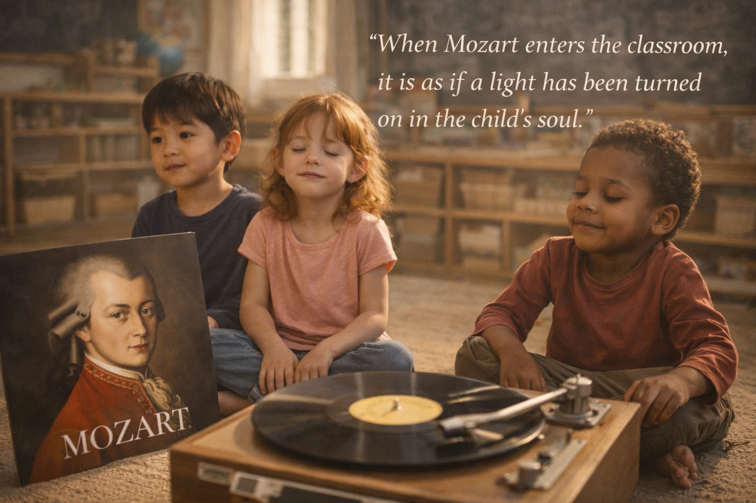
Genius flourishes in a prepared environment.
Notes:
How many of you know Wolfgang Amadeus Mozart?

Slide 4
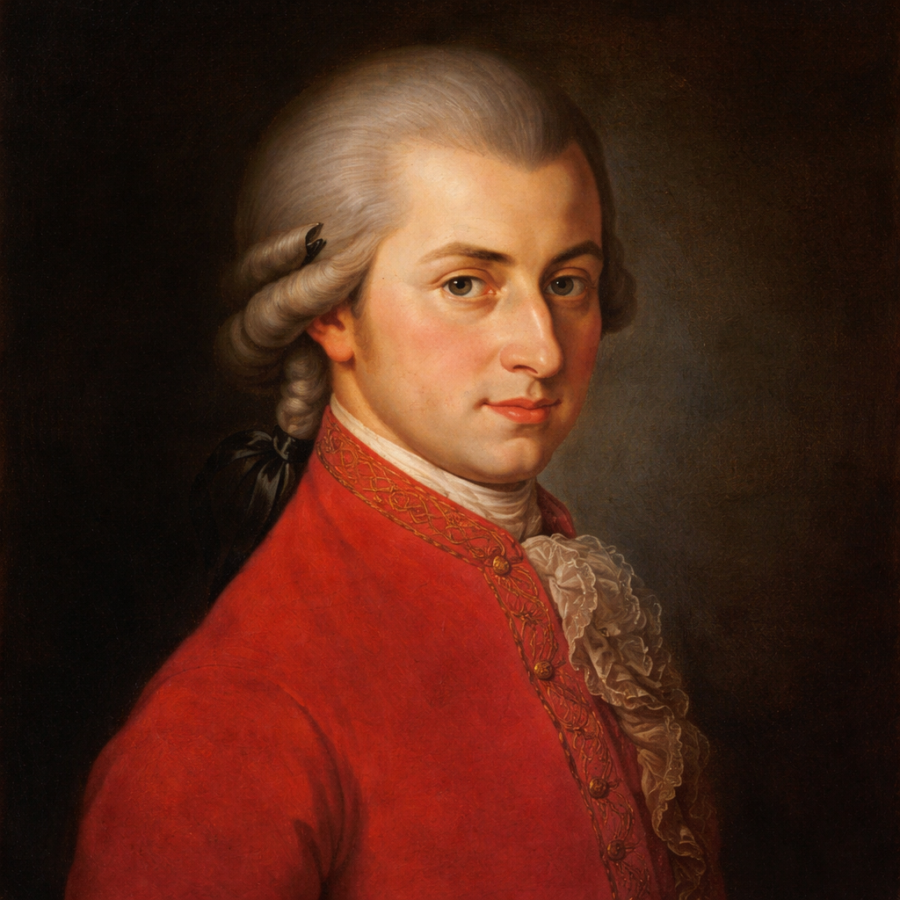
Wolfang Amadeus Mozart
By 5 Composed his first piece
By 6 Performed for Royal Courts
By 7 Was Touring Europe
By 8 Wrote an entire symphony
Notes:
By 5 years old, he composed his first piece
By 6, he was performing for royal courts in Vienna and Prague
By 7, he was touring Munich, Paris, London, and other major cities
By 8, he wrote an entire symphony

Slide 5
Wolfang Amadeus Mozart
What happened with him between ages 2 and 5 ?
Notes:
👉 What happened between ages 2 and 5?
Yes, he had a gift—definitely. But more importantly… he had something else.

Slide 6
A prepared Environment!
How well prepared is your environment for a child discover their gift?
Notes:
A prepared environment.
So my first question for you is:
👉 How well prepared is your environment for a child to discover their gift?

Slide 7
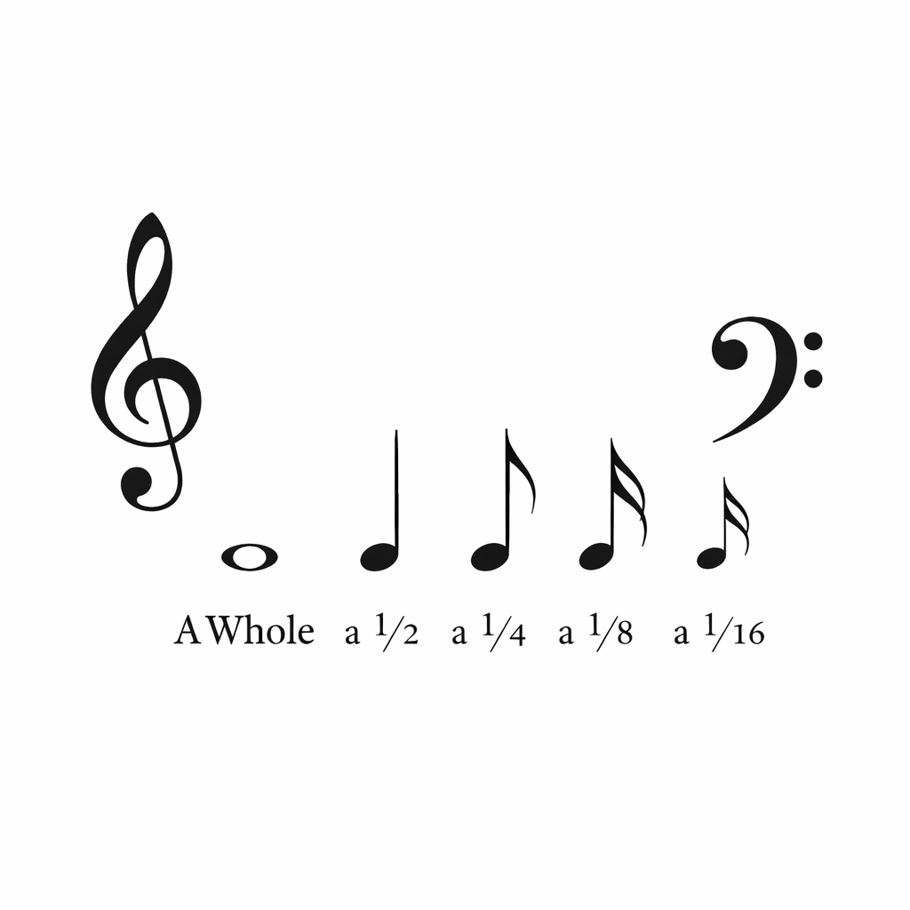
Ice Breaker!
Notes:
Let’s have a little fun.
This is going to be an interactive session, so be ready.
Are you ready? Come on… are you really ready?
I want you to give me one single clap—but only on my cue.
(Big pause)
On 3… 2… 1… Clap!
😄 Okay… that may have been a disaster—or maybe not.
But we just learned something very important:
👉 Precise instructions matter.
Let’s try again.
This time, I’ll count from 3 to 0, and when we reach zero, we all clap.
Okidoki?
3… 2… 1… 0… Clap!
How do you feel?
Do you feel that small but powerful satisfaction of completing a simple task?
That feeling—that quiet inner joy—is one of the greatest discoveries of María Montessori: the deep satisfaction that comes from purposeful activity.
And this… is just the beginning.

Slide 8

Sound Before Music
Notes:
Introduction: Sound Before Music
Let me ask you another question:
👉 What is the most ancient sound a human being ever perceived?
(Let audience answer)
Now let’s listen to this.
(Play heartbeat sound)

Slide 9

Sound Before Music
Notes:
Yes—the heartbeat.
The heartbeat is likely one of the very first sounds we perceive as human beings, along with the echoes of our mother’s voice and the voices of those closest to us.
And that heartbeat… is the foundation of rhythm.
(Play hand drum briefly)

Slide 10

Heartbeat + Nature sounds = Music
Human Nature:
We imitate
We learn by observing
Then doing
And master through REPETITION
Sounds Familiar?
Notes:
Every culture in the world began music by imitating the heartbeat—using stones, sticks, pieces of wood. Later came drums—always echoing that ancient rhythm.
Then came the voice—the sound tied to emotion, memory, and connection.
And suddenly… music is born.
Drums. Voices. Nature.
Humans listened to birds singing… to the strange sound of a toad looking for a mate… and did what humans do best:
👉 We imitate.
We learn by observing, then by doing, and we master through repetition.
Another powerful Montessori truth.

Slide 11
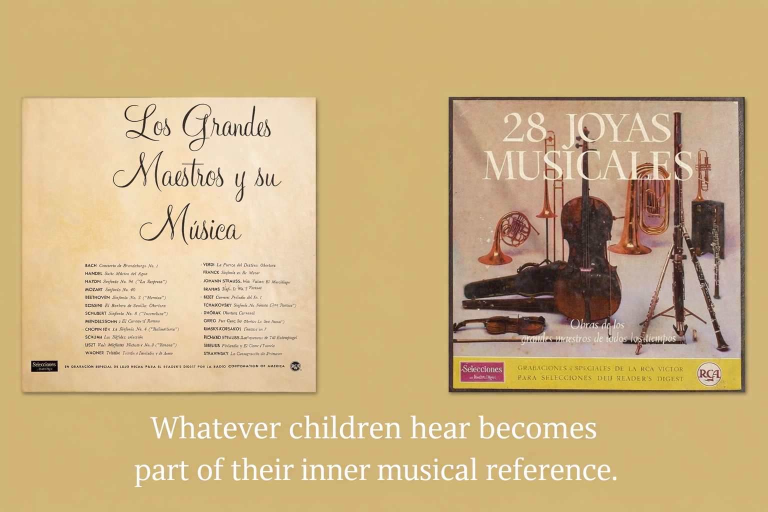
My personal Connection to music
Notes:
Personal Connection to Music
Now let me ask you something personal:
👉 Can you think of a song you loved when you were a child?
My father, he taught me how to read by 4 years old.. and back then, my hobby was reading an Illustrated Encyclopedia.
I also remember visiting my uncle with my mom. Every time we went, he would play one or two records from a Reader’s Digest collection called “The Most Beautiful Music of the World.”
Twelve vinyl records. Music from all over the world. And a booklet with stories about every composer.
By the time I was eight years old, I carried a treasure in my mind—far beyond the radio hits of the moment.
That experience shaped who I am today.
I can do many things… but my deepest passions are music and education.
And I am deeply grateful for the environment that allowed me to become who I am.

Slide 12
Wolfang Amadeus Mozart
Now, Mozart & Montessori
His parent were
I N T E N T I O N A L
Notes:
Back to Mozart… and Montessori
So let’s go back to Mozart.
What truly made the difference in his life?
👉 His parents.
Leopold Mozart was intentional about music education. And Wolfgang’s mother, Anna Maria, was equally intentional.
That intention… matters.
In Montessori education, we talk about prepared environments—not just for learning, but for life.
We prepare the way for future composers, artists, professionals, and—most importantly— human beings who love what they do.

Slide 13
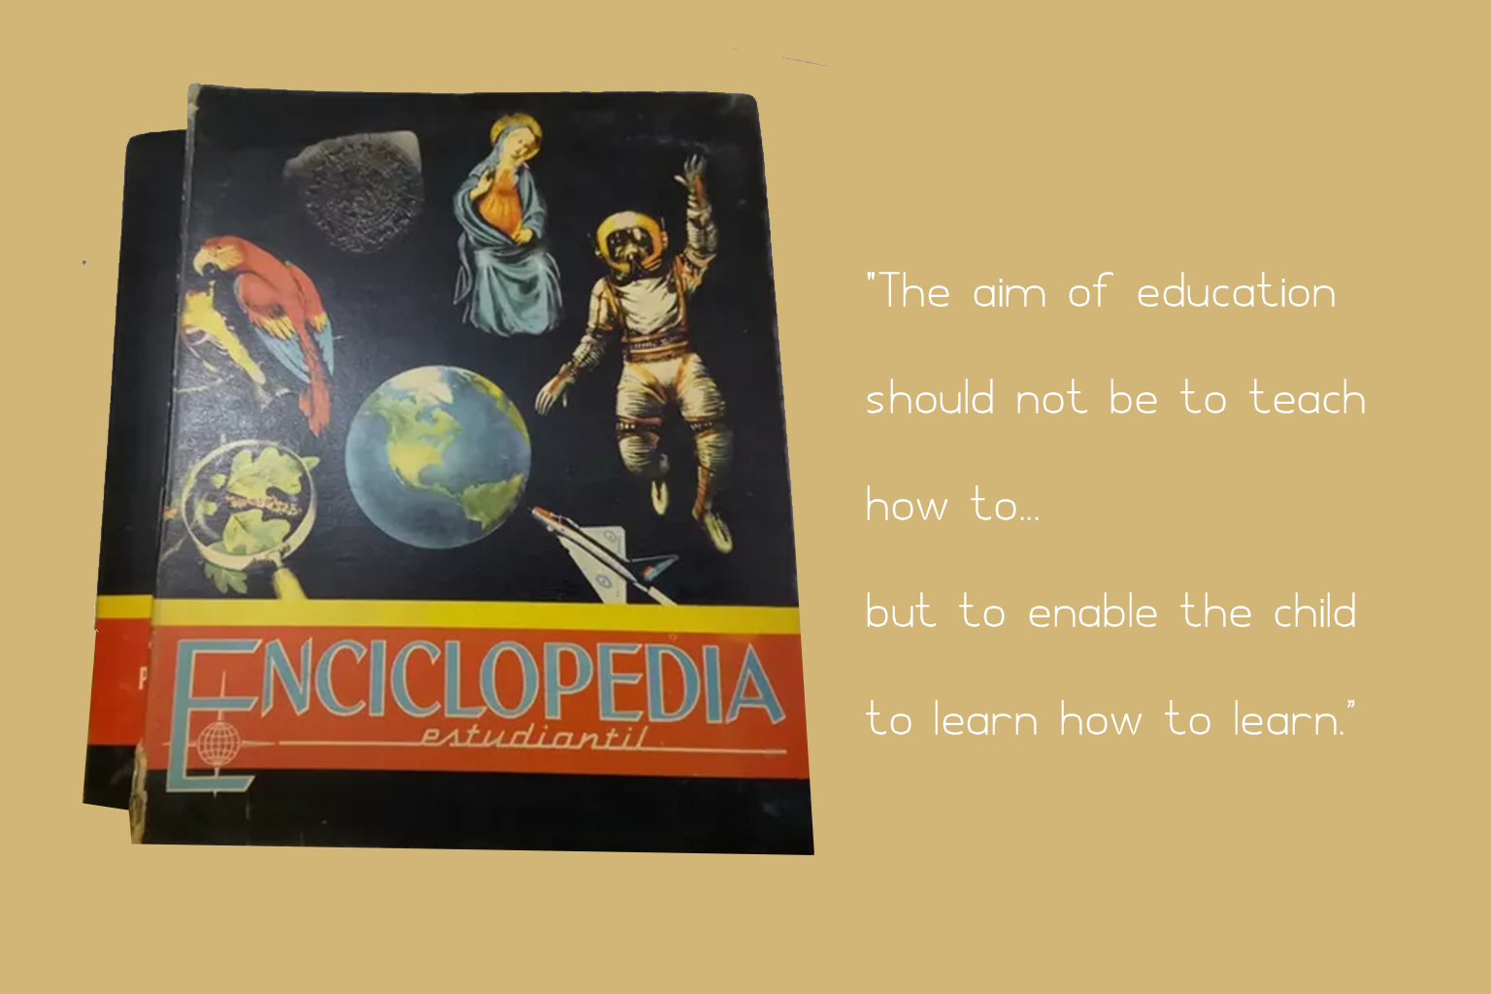
Montessori definition: “Learning how to learn, and loving it”
Notes:
Lectura de los 4 años

Slide 14
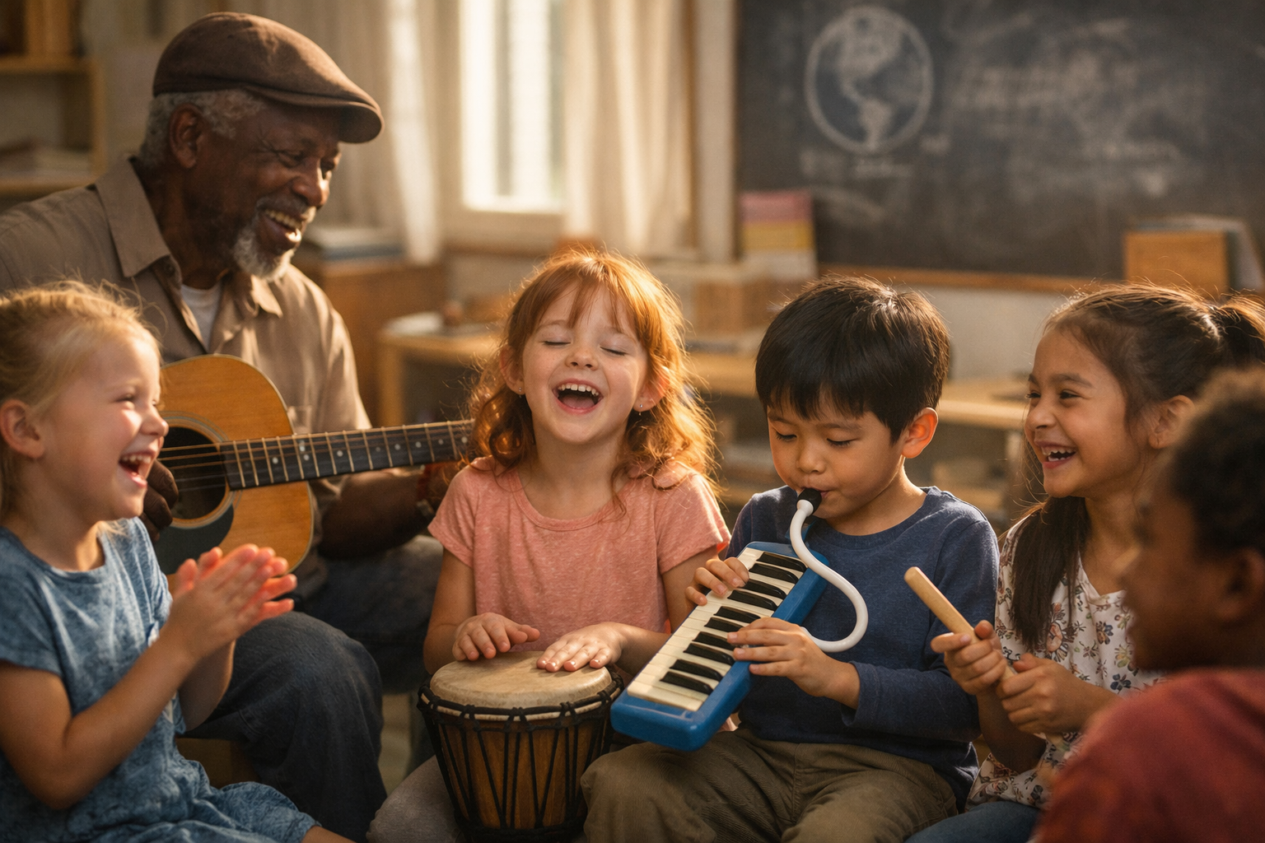
Music is a universal language, understood before words.
Why Is Music So Important?
So you may ask:
Why music?
Because:
Allows us to connect with our inner self
We love rhythm
Allows us to express emotion
Song lyrics stay with us… sometimes for a lifetime
Notes:
Why Is Music So Important?
So you may ask:
👉 Why music?
Because:
It allows us to connect with our inner self
Because we love rhythm
Because it allows us to express emotion
And because song lyrics stay with us… sometimes for a lifetime

Slide 15
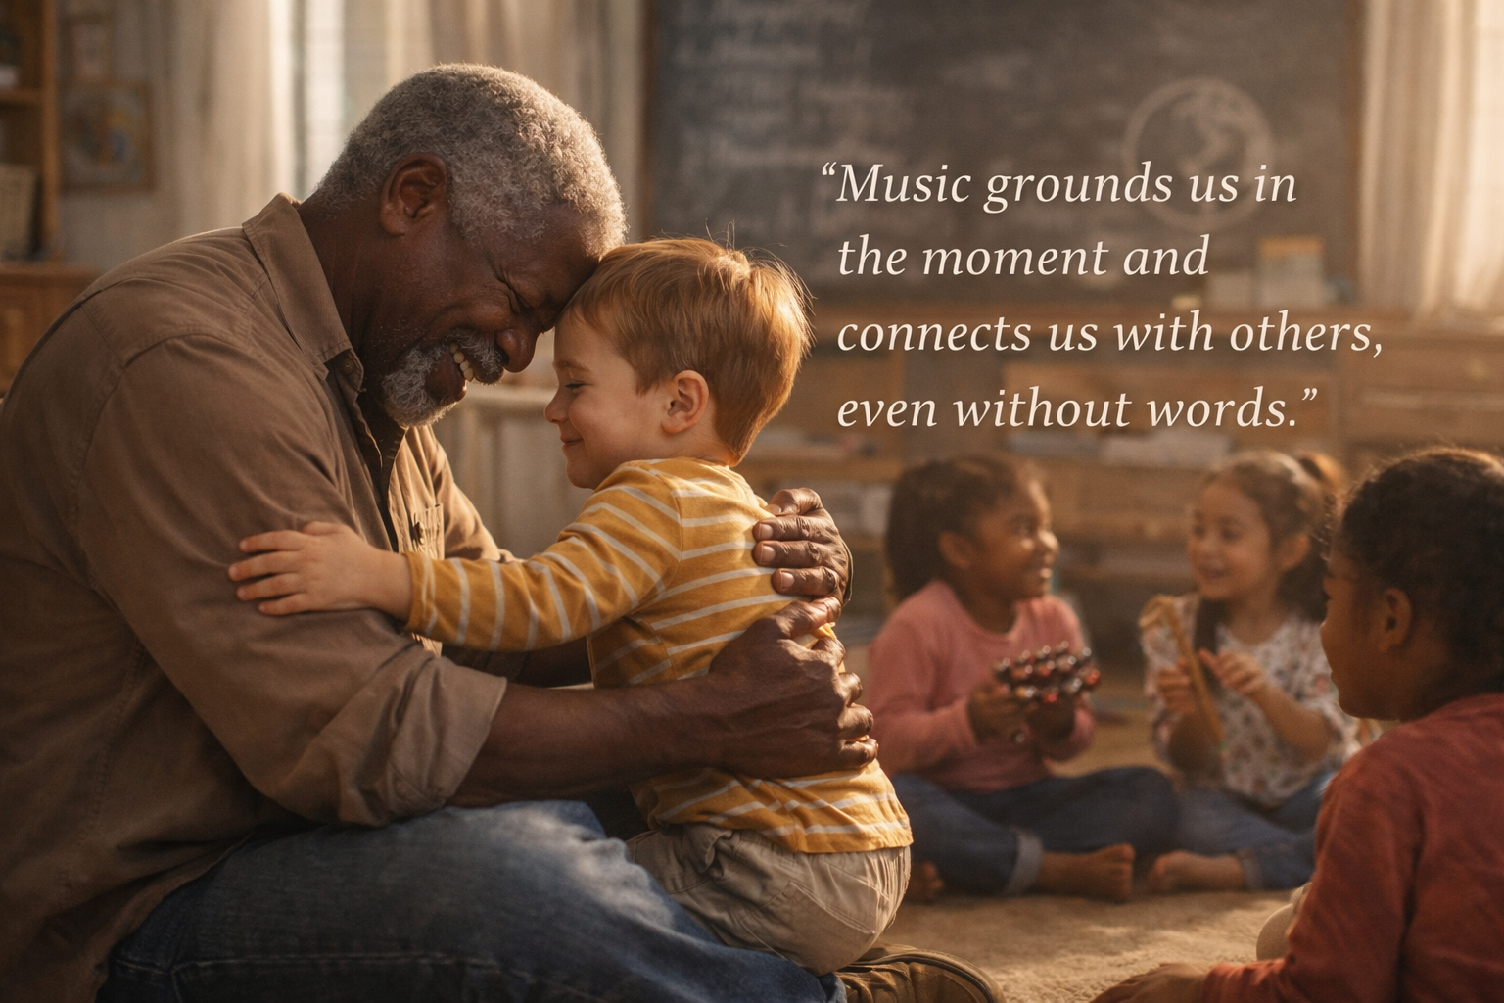
The Heart of This Conference
Music is a Development Catalyst?
For children 4 -5
Cognitive growth
Emotional development
Social Connection
Notes:
Now let’s get to the heart of why we’re here today.
When we hear the word music, we often think of art, fun, concerts—or even chaos.
But music is much more than that.
Music is a powerful developmental catalyst, especially during the early years of life.
For children in the first plane of development, particularly between ages 2 and 5, music provides a unique pathway for:
Cognitive growth
Emotional development
Social connection
Let’s explore how rhythm, movement, and language through music support holistic development—especially within Montessori environments.

Slide 16
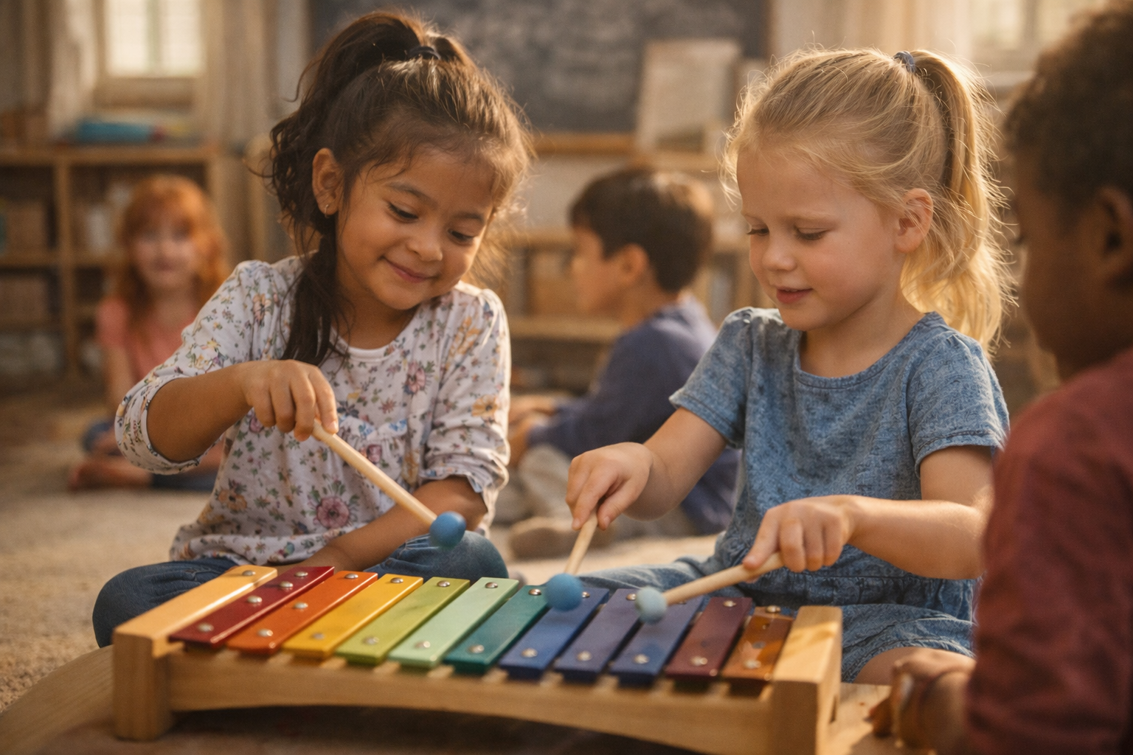
Neurological Foundations
Reaches multiple areas of the brain at the same time
Strengths Neural connections that support:
Language acquisition
Memory
Executive function
Stimulates the motor cortex,
Coordination
Balance
Fine motor control
Notes:
Neurological Foundations
One of the most remarkable aspects of music is that it reaches multiple areas of the brain at the same time.
Music strengthens neural connections that support:
Language acquisition
Memory
Executive function
Exposure to rhythm enhances temporal processing, which is directly linked to early literacy and numeracy.
When movement is paired with music, it stimulates the motor cortex, improving:
Coordination
Balance
Fine motor control

Slide 17
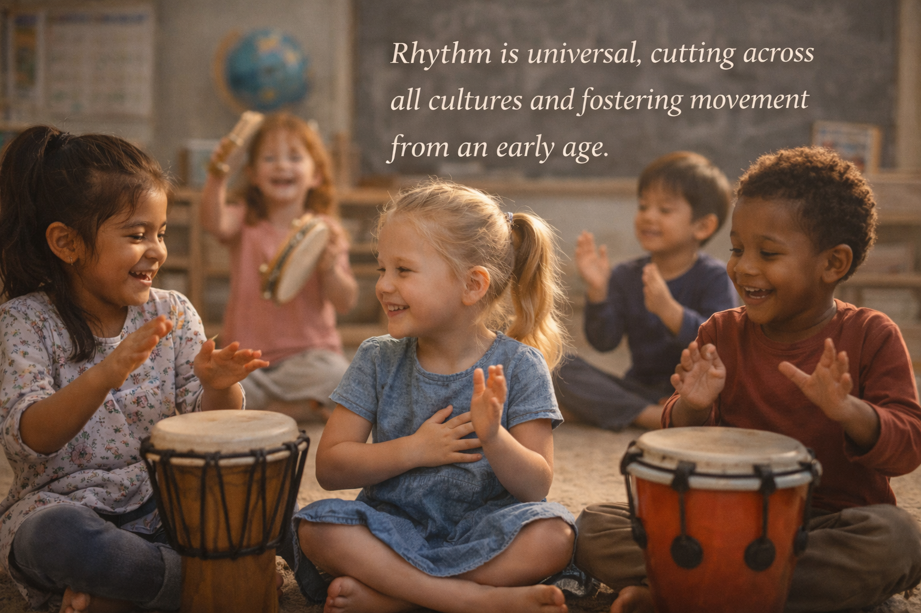
Emotional and Social Growth
Helps child develop:
Emotional Regulation
Empathy
Self Expression
Group Singing encourages:
Collaboration
Patience
Social Bonding
Notes:
Emotional and Social Growth
Musical experiences help children develop:
Emotional regulation
Empathy
Self-expression
Group singing and rhythmic play encourage:
Collaboration
Patience
Social bonding

Slide 18
Cognitive and Linguistic Benefits
Song lyrics introduce:
New Vocabulary
Sintax
Conceptual Understanding
And because music is repetitive and joyful, it supports memory consolidation and comprehension of abstract ideas.
Notes:
Cognitive and Linguistic Benefits
Song lyrics introduce:
New vocabulary
Syntax
Conceptual understanding
And because music is repetitive and joyful, it supports memory consolidation and comprehension of abstract ideas.

Slide 19
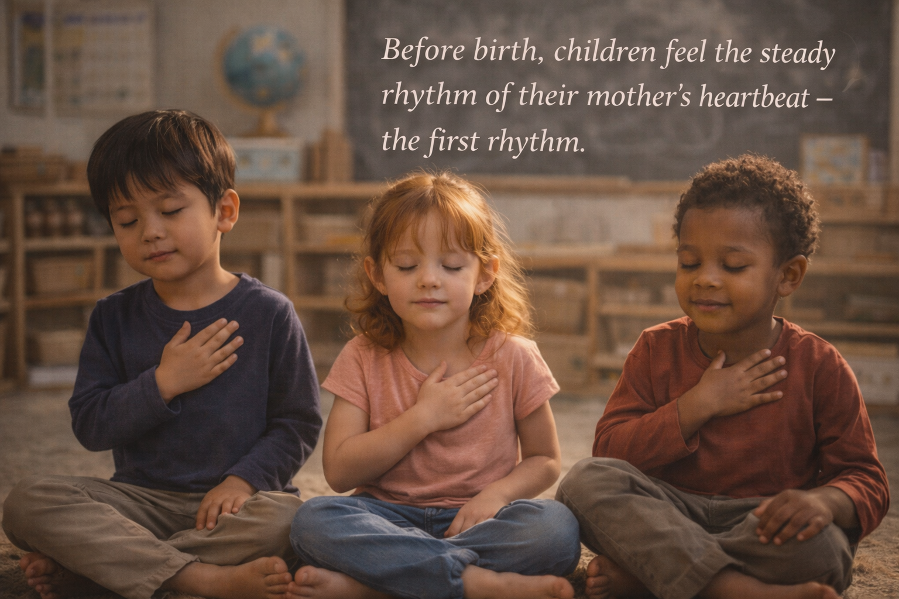
Music and Montessori: A Natural Alignment
Integrates with:
Sensory exploration
Independence
Self-directed learning
Activities like:
Rhythmic clapping
Movement games
Lyrical storytelling
Music nurture concentration, creativity, and joy in discovery.
Notes:
Music and Montessori: A Natural Alignment
Music integrates beautifully with Montessori principles:
Sensory exploration
Independence
Self-directed learning
Activities like:
Rhythmic clapping
Movement games
Lyrical storytelling
nurture concentration, creativity, and joy in discovery.

Slide 20
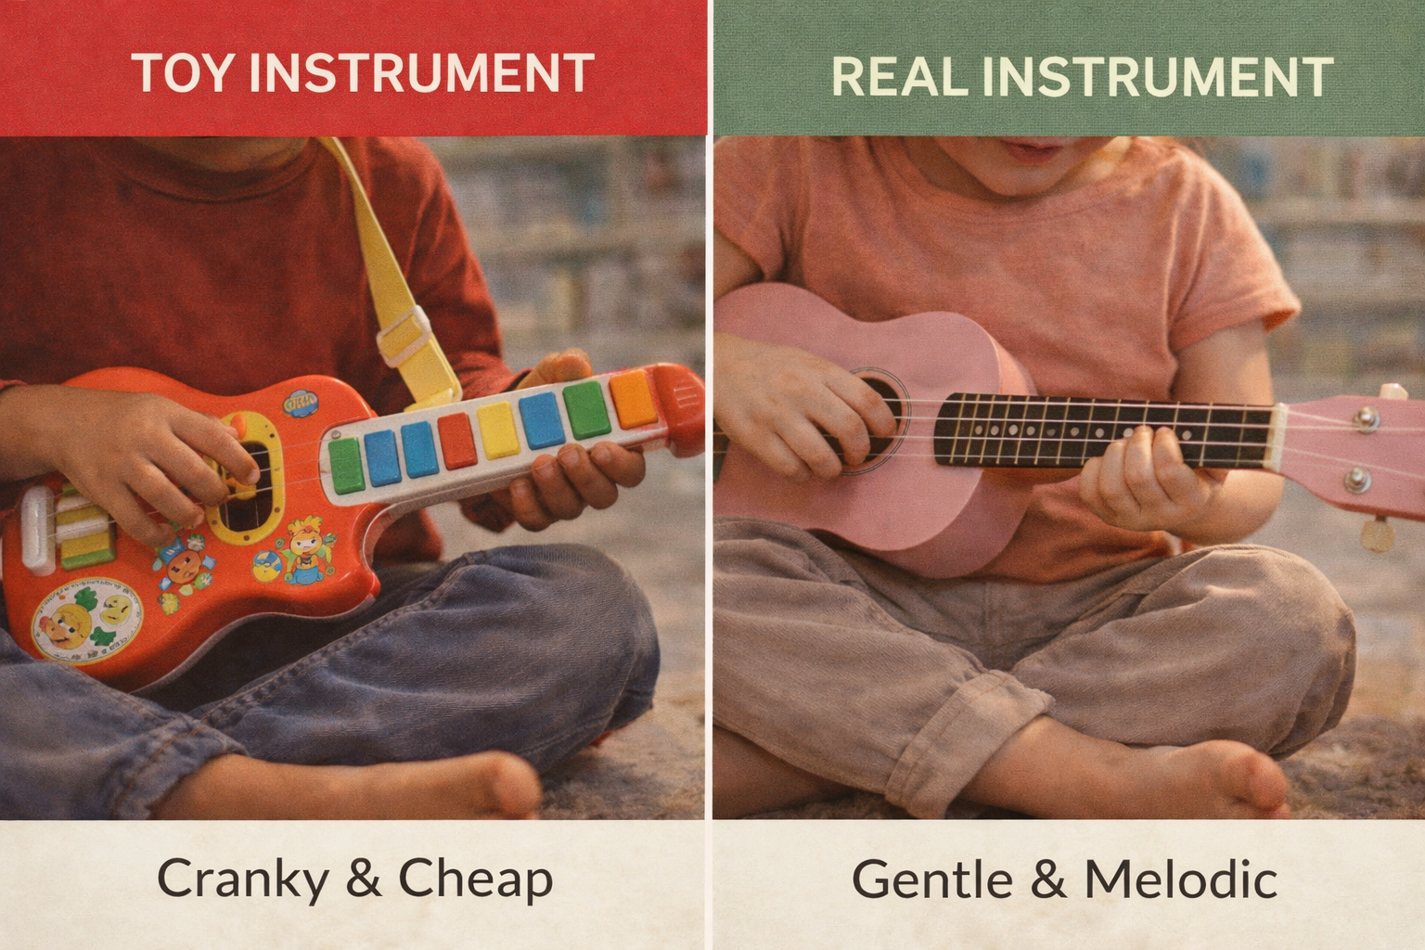
We should avoid using toy instruments
Notes:
Real Instrument vs Toy Instruments
A child can discover a love for an instrument by being exposed to different sounds and having the opportunity to explore them in a relaxed, playful way. When children are free to listen, touch, and experiment with instruments, they begin to notice which ones feel exciting and meaningful to them. Observing others play music, hearing live performances, and using simple, child-sized instruments can spark curiosity and joy. Over time, the instrument a child naturally returns to—the one they enjoy playing and feel proud of—often becomes the instrument they truly love.
Before we close, there is one very important point I would like to emphasize.
In early childhood, we should avoid using toy instruments.

Slide 21
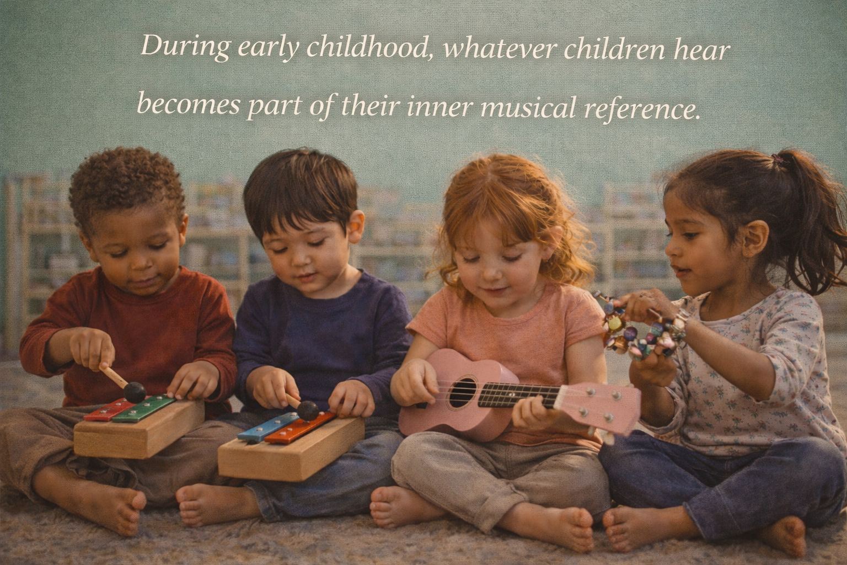
Children absorbe everything!
Their ears are being trained
Distorted or untuned sounds teach the ear to accept imprecision
Real Instruments offer
Truth,
Beauty and
Accuracy
Notes:
Toy instruments often produce out-of-tune sounds. They may look cute, but the notes are inaccurate, and during this very sensitive period of development, whatever the child hears becomes part of their inner musical reference.
At this stage of life, children are not just playing with sound—they are absorbing it.
Their ears are being trained.
If we offer distorted or untuned sounds, we are unintentionally teaching the ear to accept imprecision. But if we offer real instruments, even simple ones—real drums, real bells, real string instruments—we are offering truth, beauty, and accuracy.
This is deeply Montessori.
We don’t give children toy tools in practical life—we give them real tools, sized for their hands.

Slide 22
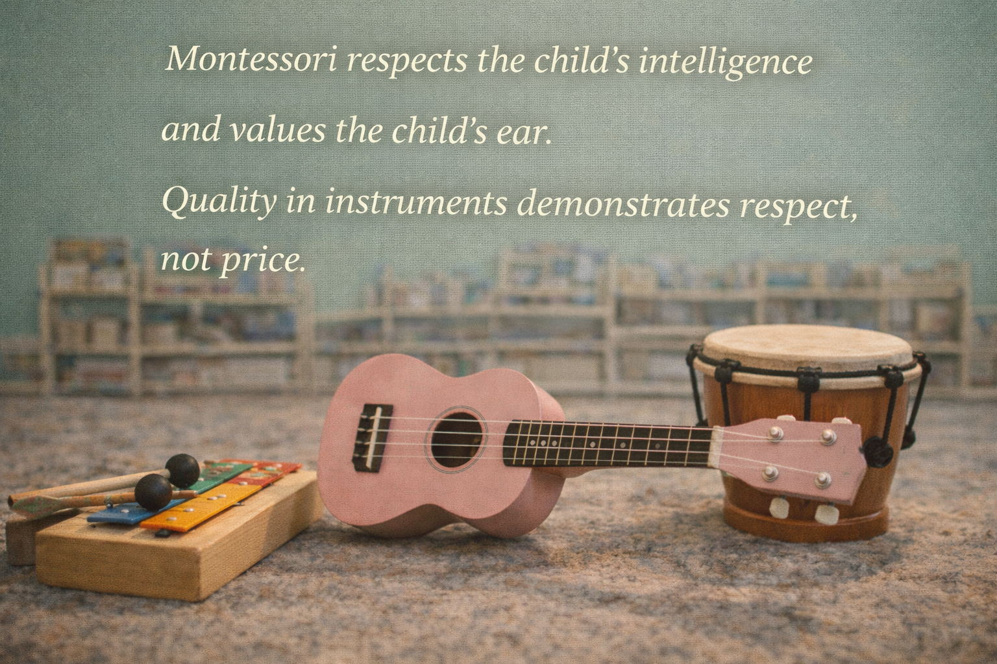
Notes:
The same principle applies to music.
👉 Real instruments communicate respect. 👉 Real instruments educate the ear. 👉 Real instruments honor the child’s sensitive period for sound.
Whatever they listen to now… will stay with them for life.

Slide 23
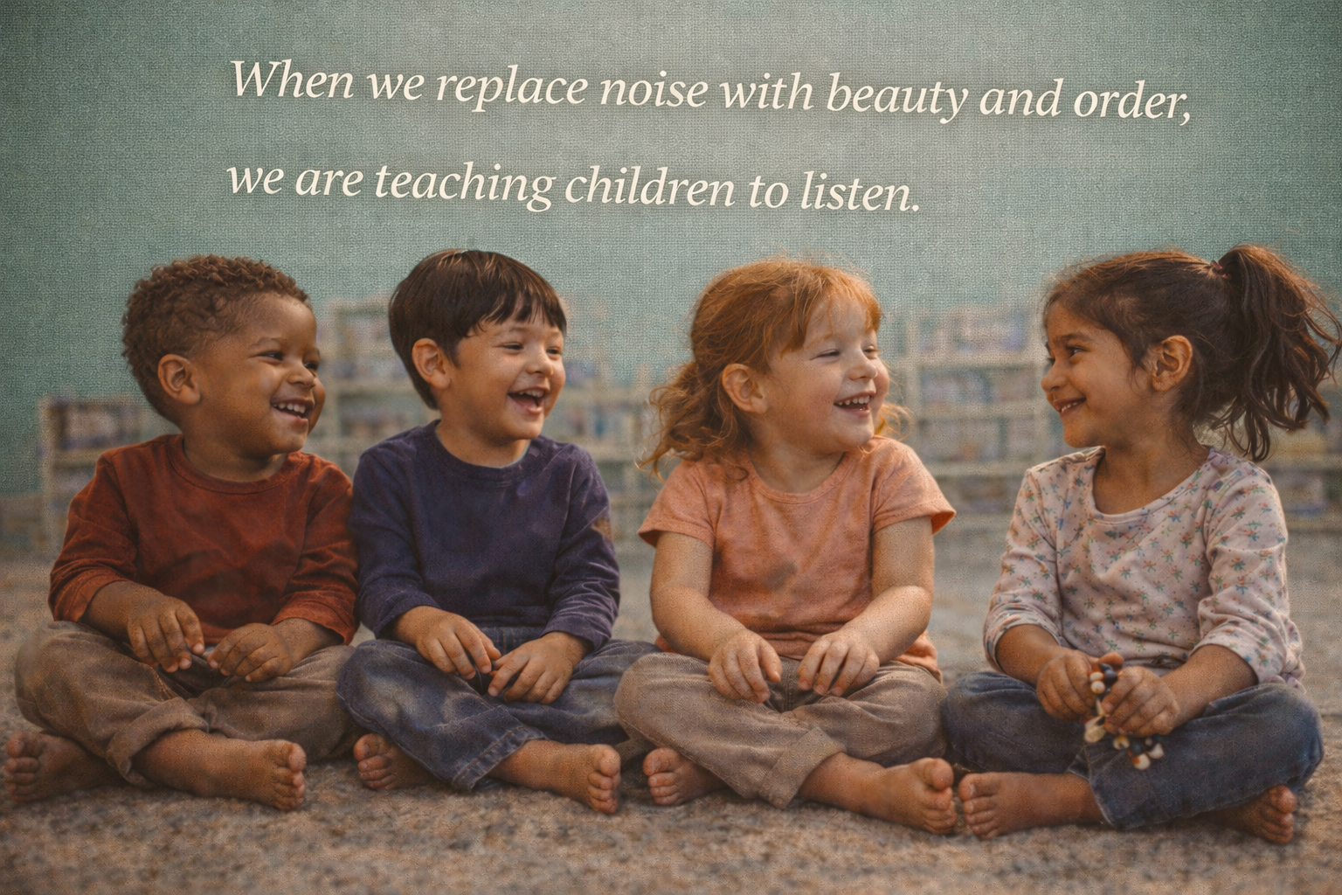
1 – Rythm & Movement (First musical exploration Ages 2-4)
Music Shelfs
Suggested Instruments
1. Hand Drum (real drum)
Natural or high-quality synthetic drumhead
Small to medium size
Foundation for pulse and coordination
2. Wooden Rhythm Sticks (claves)
Solid wood
Excellent for bilateral coordination
3. Small Frame Drum with Mallet
Encourages gentle, controlled movement
Introduces dynamic control
4. Sleigh Bells (tuned)
Ring or wrist style
Ideal for walking with rhythm
5. Natural Shakers (seeds, rice, metal)
Clear, defined sound (not harsh)
Limit to one or two variations
Notes:
Suggested Instruments
1. Hand Drum (real drum)
Natural or high-quality synthetic drumhead
Small to medium size
Foundation for pulse and coordination
2. Wooden Rhythm Sticks (claves)
Solid wood
Excellent for bilateral coordination
3. Small Frame Drum with Mallet
Encourages gentle, controlled movement
Introduces dynamic control
4. Sleigh Bells (tuned)
Ring or wrist style
Ideal for walking with rhythm
5. Natural Shakers (seeds, rice, metal)
Clear, defined sound (not harsh)
Limit to one or two variations

Slide 24
1 – Rythm & Movement (First musical exploration Ages 2-4)
Music Shelfs
Developmental Benefits
Internal sense of pulse
Gross motor coordination
Emotional regulation
Movement control
Body awareness
Notes:
Developmental Benefits
Internal sense of pulse
Gross motor coordination
Emotional regulation
Movement control
Body awareness

Slide 25
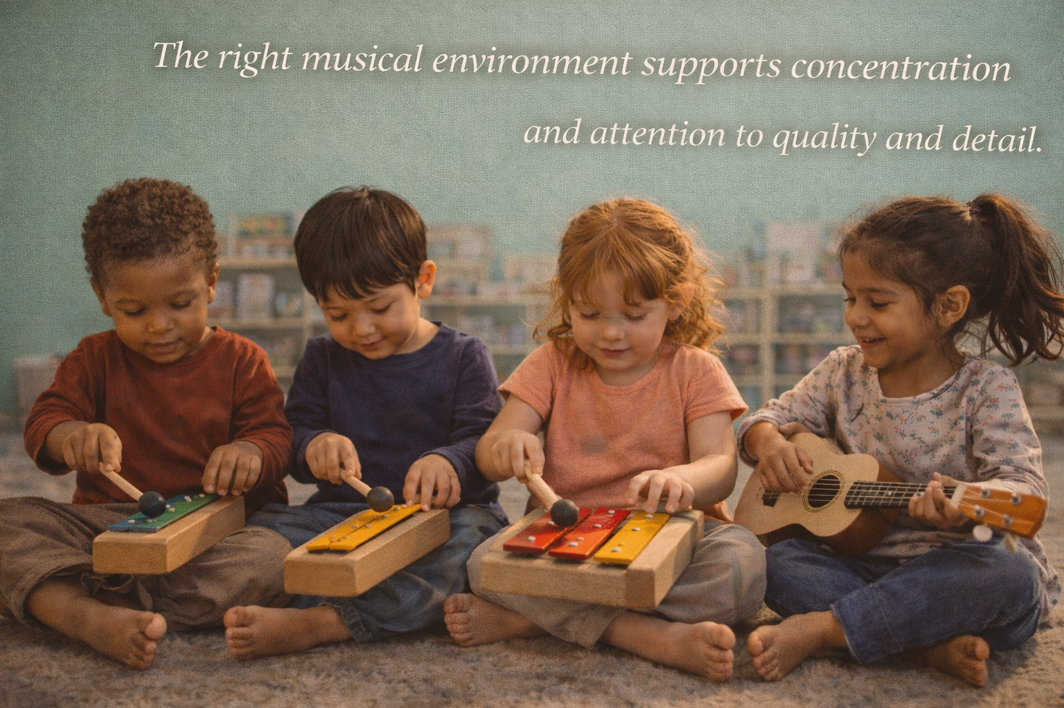
2 – Melody & Listening (Refinement of the ear Ages 3-5)
Music Shelfs
Suggested Instruments
1. Montessori Bells (tuned bells)
Ideally chromatic
With dampers
Cornerstone material for ear training
2. Small Wooden Xylophone (accurately tuned)
Wooden or metal bars
One or two soft mallets
3. Child-Sized Glockenspiel (real, tuned)
Bright but controlled tone
Clear pitch discrimination
4. Tone Bars (individual pitch bars)
Excellent for auditory discrimination
Isolates the concept of pitch
5. Small String Instrument (optional)
Real ukulele or small lyre
For exploring vibration, not performance
Notes:
Suggested Instruments
1. Montessori Bells (tuned bells)
Ideally chromatic
With dampers
Cornerstone material for ear training
2. Small Wooden Xylophone (accurately tuned)
Wooden or metal bars
One or two soft mallets
3. Child-Sized Glockenspiel (real, tuned)
Bright but controlled tone
Clear pitch discrimination
4. Tone Bars (individual pitch bars)
Excellent for auditory discrimination
Isolates the concept of pitch
5. Small String Instrument (optional)
Real ukulele or small lyre
For exploring vibration, not performance

Slide 26
Music Shelfs
2 – Melody & Listening (Refinement of the ear Ages 3-5)
Developmental Benefits
Auditory discrimination
Sound memory
Sustained attention
Indirect preparation for language and mathematics
Aesthetic sensitivity
Notes:
Developmental Benefits
Auditory discrimination
Sound memory
Sustained attention
Indirect preparation for language and mathematics
Aesthetic sensitivity
📐 SHELF DESIGN (VERY IMPORTANT)
Height
At the chest level of the youngest child
Material
Natural wood (birch, maple, pine)
Neutral tones, no bright colors
Order
Each instrument has a defined place
No stacking
Always returned to the same spot
Quantity
Better to have 6 well-chosen instruments than 15 poorly tuned ones
🎶 KEY PHRASE (SUMS IT UP)
In Montessori, music is not entertainment — it is education for the ear, the body, and the soul.

Slide 27
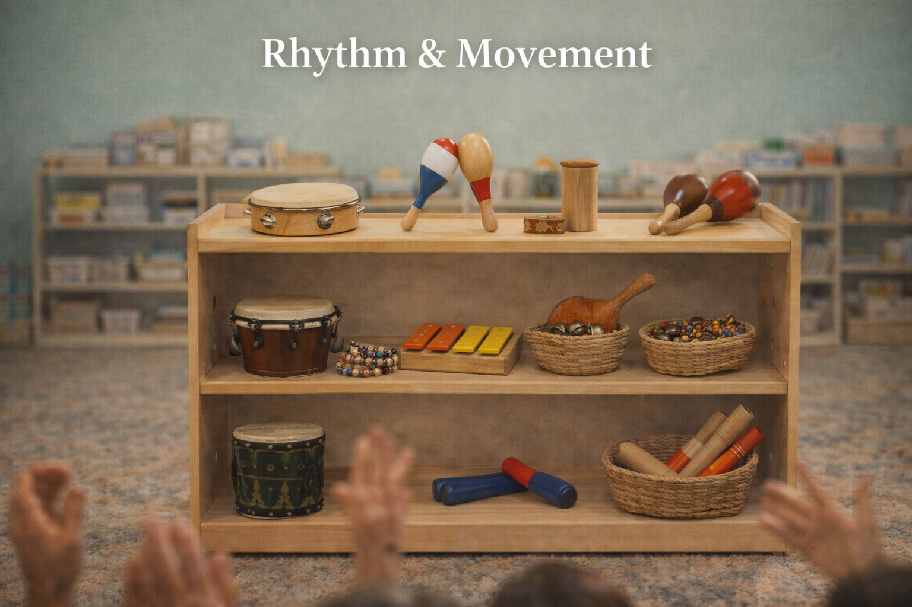
Music Shelfs
3 – Shelf Design
SHELF DESIGN (VERY IMPORTANT)
Height
At the chest level of the youngest child
Material
Natural wood (birch, maple, pine)
Neutral tones, no bright colors
Order
Each instrument has a defined place
No stacking
Always returned to the same spot
Quantity
Better to have 6 well-chosen instruments than 15 poorly tuned ones
In Montessori, music is not entertainment — it is education for the ear, the body, and the soul.
Notes:
📐 SHELF DESIGN (VERY IMPORTANT)
Height
At the chest level of the youngest child
Material
Natural wood (birch, maple, pine)
Neutral tones, no bright colors
Order
Each instrument has a defined place
No stacking
Always returned to the same spot
Quantity
Better to have 6 well-chosen instruments than 15 poorly tuned ones
🎶 KEY PHRASE (SUMS IT UP)
In Montessori, music is not entertainment — it is education for the ear, the body, and the soul.

Slide 28

Q&A
Notes:
Closing
By intentionally weaving music into daily classroom practice, Montessori educators can harness its neurological and developmental power.
Music helps children build strong foundations—not only for learning, but for life.
And when we prepare the environment with intention, we are not just teaching children…
👉 We are helping them discover who they are meant to become.
Thank you.
Q&A
.

Slide 29

Contact: Arturo de la Mora
Arturo@ngmschools.com

Slide 30
Montessori Environment Music Free for Montessori Teachers and Schools
Notes:
Closing reflection. Music prepares children for life, not just musicians.

